Slide 1
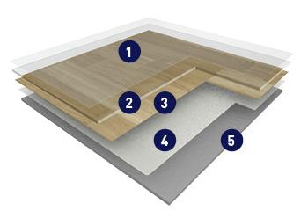
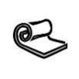
NEROK ACOUSTIC : PRODUCT DESCRIPTION
NEROK is a multilayered vinyl floor covering available in 2m and 4m wide sheet, with a group T wear rating.
The product comprises a foam backing reinforced with a glass fiber veil and a printed design that is protected by a transparent wearlayer. It offers a -19 dB sound insulation and a resistance to indentation of 0.10 mm.
This flooring is protected by the surface treatment, PUR+ mat, ensuring easy maintenance and no required polish for the entire lifetime of the product.
It does not contain any heavy metals or CMR 1&2 components, 100% compliant with REACH. The product emission rate of volatile organic compounds is <100µg/m³ (TVOC after 28 days ISO 16000-6).
It is 100% recyclable.
3,4 mm
1
PUR+ mat surface treatment
2
Transparent wearlayer
3
Printed Design
4
Glass fiber veil
Wide of sheet : 200 cm – 400 cm
Length of sheet : 25 lm
5
Acoustic foam underlayer

